Slide 1
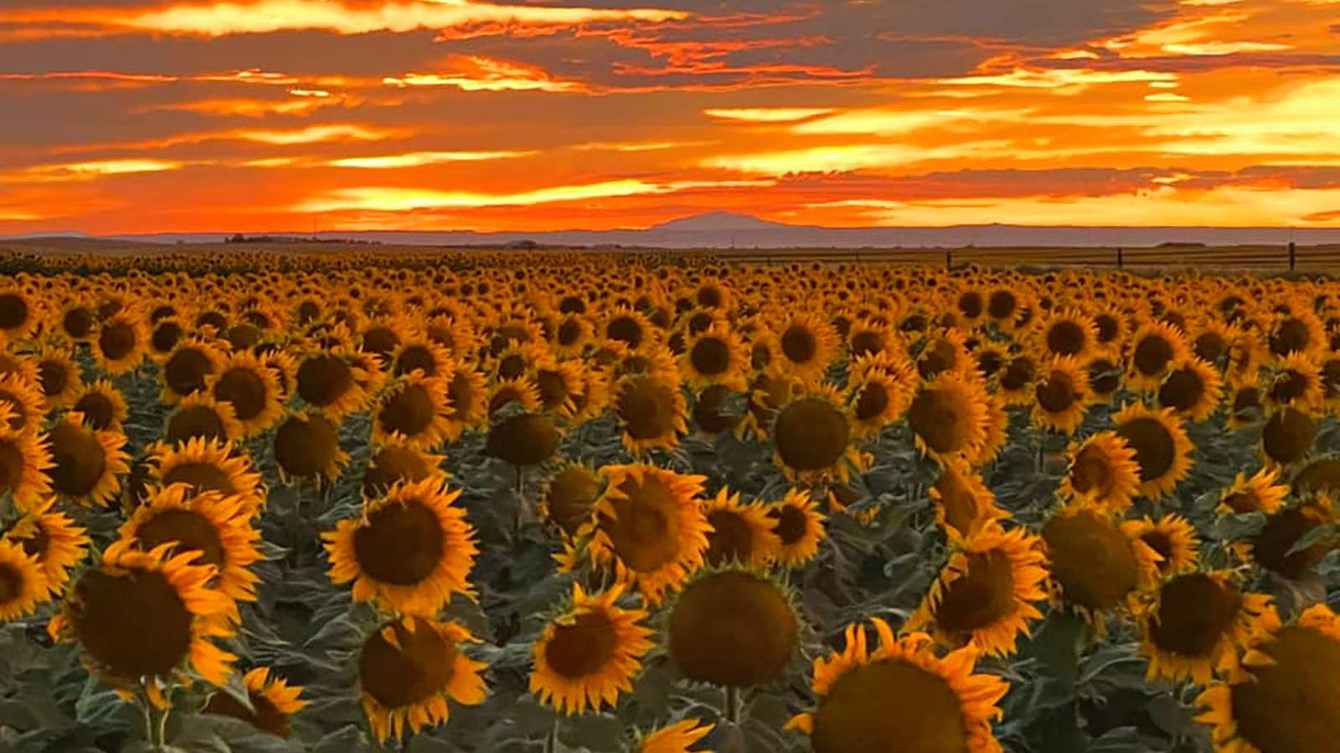
Sunflower Swing Results!
Congrats!

Slide 2
After Dinner Speaking
There were 5 finalists in the final round of After Dinner Speaking.
In 5th place, from George Mason University, Emma Redden.
In 4th place, from Ball State University, Alex Wagler
In 3rd place, from Bethel College, Emil Benavides
In 2nd place, from Ball State University, Marie Scudder.
In 1st place, from University of Minnesota, Gursimrat Dahry

Slide 3
Communication Analysis
There were 6 finalists in Communication Analysis.
In 6th place, from University of Nebraska Omaha, Abigail Faris
In 5th place, from George Mason University, Emma Schaible
In 4th place, from Ball State University, Zoe Pointer.
In 3rd place, from Hastings College, Bri Narick
In 2nd place, from George Mason University, Freya Hutton
In 1st place, from Cornell University, Hayden Watkins

Slide 4
Dramatic Interpretation
There were 5 finalists in Drama Interpretation
In 5th place, from South Dakota State University, Abby Steffes
In 4th place, from Concordia University, Nebraska, Madelyn Graham
In 3rd place, from George Mason University, Cassidy Gunter
In 2nd place, from University of Wisconsin-Madison, William Laudon
In 1st place, from George Mason University, Grace Cora.

Slide 5
Duo Interpretation
There were two finalists in Duo Interpretation
In 2nd place, from George Mason University, Emma Redden and Ava Parker
In 1st place, from University of Nebraska Omaha, Abigail Faris and Bekah Evans.

Slide 6
Extemporaneous Speaking
There were 5 finalists in the final round of Extemporaneous Speaking.
In 5th place, from Kansas State IE, Maya Daily
In 4th place, from University of Wisconsin-Madison, Mason McWherter
In 3rd place, from University of Nebraska-Lincoln, Elizabeth Harding
In 2nd place, from Cornell University, Hayden Watkins
In 1st place, from University of Wisconsin-Madison, William Laudon

Slide 7
Impromptu Speaking
There were 6 finalists in the final round of Impromptu Speaking.
In 6th place, from George Mason University, Cassidy Gunter
In 5th place, from Cornell University, Hayden Watkins
In 4th place, from George Mason University, Emma Redden
In 3rd place, from Bethel College, Preston Vicenzi
In 2nd place, from University of Nebraska-Lincoln, Kayli Pham
In 1st place, from University of Minnesota, Gursimrat Dahry

Slide 8
Informative Speaking
There were 6 finalists in the final round of Informative Speaking.
In 6th place, from Cornell University, Sahithi Mullapudi
In 5th place, from Hastings College, Lilac Ramsey
In 4th place, from University of Nebraska-Lincoln, Hailey Cheek
In 3rd place, from Cornell University, Niki Khare
In 2nd place, from Cornell University, Megan Nguyen
In 1st place, from University of Nebraska Omaha, Brooklynn Schmidt

Slide 9
Persuasive Speaking
There were 5 finalists in the final round of Persuasive Speaking.
In 5th place, from Hofstra University, Caroline Cassidy .
In 4th place, from University of Nebraska-Lincoln, Emma Cavalier
In 3rd place, from University of Nebraska-Lincoln, Sydnee Wenninghoff
In 2nd place, from Cornell University, Jaliah Smith
In 1st place, from University of Nebraska-Lincoln, Elizabeth Harding

Slide 10
Poetry Interpretation
There were 6 finalists in Poetry Interpretation
In 6th place, from University of Nebraska Omaha, Dylan Harris
In 5th place, from University of Nebraska Omaha, Mak Ruffing
In 4th place, from South Dakota State University, Esther Ilunga
In 3rd place, from University of Nebraska-Lincoln, Tamyia Bender
In 2nd place, from George Mason University, Vera Sandi Alvarado
In 1st place, from University of Nebraska-Lincoln, Kallum Osborne

Slide 11
Program Oral Interpretation
There were 5 finalists in the final round of Program Oral Interpretation.
In 5th place, from Hastings College, Lilac Ramsey
In 4th place, from University of Wisconsin-Madison, Lily Wamser
In 3rd place, from George Mason University, Lexi Martinez
In 2nd place, from Ball State University, Charlotte Jons
In 1st place, from Hastings College, Bri Narick

Slide 12
Prose Interpretation
There were 6 finalists in the final round of Prose Interpretation.
In 6th place, from University of Nebraska-Lincoln, Sydnee Wenninghoff
In 5th place, from Ball State University, Madilyn O'Connell
In 4th place, from Eastern Michigan University, Hannah Ihrig
In 3rd place, from University of Nebraska Omaha, Colin Gibbons
In 2nd place, from University of Nebraska-Lincoln, Kallum Osborne
In 1st place, from Cornell University, Sofia Spillane

Slide 13
Team Sweepstakes
In 3rd place, with 68 points, the team from Cornell University.
In 2nd place, with 74 points, the team from George Mason University.
In 1st place, with 82 points, the team from University of Nebraska-Lincoln.

Slide 14
Individual Sweepstakes
There was a 2-way tie for 3rd place.
With 22 points, from University of Wisconsin-Madison, William Laudon.
With 22 points, from University of Nebraska-Lincoln, Kallum Osborne.
In 2nd place, with 24 points, from University of Minnesota, Gursimrat Dahry
In 1st place, with 26 points, from Cornell University, Hayden Watkins.

